Slide 1
SEO
A Lecture by Usman Akram for CIIT Lahore Students

Slide 2
Intro
Search engine optimization (SEO) is the process of affecting the visibility of a website or a web page in a search engine's "natural" or unpaid ("organic") search results.
There are two types of SEO: On page SEO and Off page SEO
On –Page SEO :- on-page optimization refers to factors that have an effect on your Web site or Web page listing in natural search results.
Off –Page SEO :- Off page SEO refers to techniques that can be used to improve the position of a web site in the search engine results page (SERPs).

Slide 3
Definitions
SE = Search Engine is a tool that enables users to locate information on the World Wide Web. Search engines use keywords entered by users to find Web sites which contain the information sought.
Web Directory = a search service that arranges the web pages it knows about into categories and subcategories. Often picked by human beings for inclusion in the categories.

Slide 4
Definitions
SEO / SEM = A form of online marketing, Search Engine Optimization / Search Engine Marketing is the process of making a site and its content highly relevant for both search engines and searchers. Successful search marketing helps a site gain top positioning for relevant words and phrases.
PR = Page Rank a system for ranking web pages developed by Google - http://toolbar.google.com
PPC = Pay Per Click online advertising payment model in which payment is based solely on qualifying click-through.

Slide 5
Definitions
CTR = Click Through Rate advertising term indicating the percentage of viewers who click on a banner advertisement and follow the link
BLOGS = a frequent, chronological publication of personal thoughts and Web links
RSS = Real Simple Syndication

Slide 6
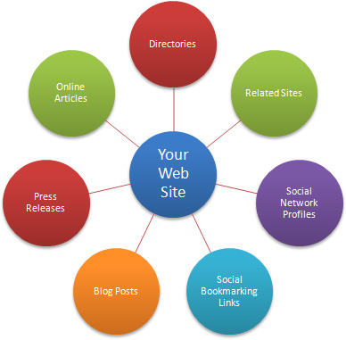
SEO & Link building - Strategy and Definition of Goals
process of establishing relevant, inbound links
Directory submission
Dofollow blog comments
Dofollow forums
Dofollow socoial bookmarking website Etc.

Slide 7
Google Updates, Penalties and Filters
Google has a long history of famous algorithm updates, search index changes and refreshes.
Google Hummingbird
Google Panda Update
Google Penguin Update
Google Pigeon Update
Google Payday Update
Google Pirate Update
Google EMD (Exact Match Domain) Update
Google Top Heavy Update

Slide 8
Unnatural links
creating links that weren’t editorially placed or vouched for by the site’s owner on a page

Slide 9
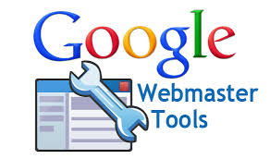
Google Webmaster Tools
Google Webmaster Tools is a no-charge web service by Google for webmasters. It allows webmasters to check indexing status and optimize visibility of their websites.Google Webmaster Tools shows traffic for each keyword separately; it gives more information about website performance according to Google search query.

Slide 10
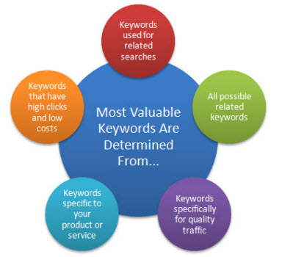
KeyWord Search
There are different tools for keyword Research:
Google Adword Keyword Planner
Keyword Eye
Keyword Spy

Slide 11
SEO Process
Domain Name
use keywords, location, advertising terms, product name
choose a keyword that is important for your business
Linking
Keywords
Submit your website to SEs

Slide 12
Perfectly Optimized On-page SEO Checklist
Content is high-quality, relevant, fresh and at least 500 words in length.
Target search phrase is included in page headline.
Target search phrase is included in at least one sub-headline.
Target search phrase is repeated three to 10 times within body copy. Don’t over-do it, or the page may get downgraded as spam. Keep the reader in mind as you work with the target search phrase. Copy should always be reader-friendly.
Page includes relevant images and/or graphics that help illustrate the target search phrase.

Slide 13
Perfectly Optimized On-page SEO Checklist
Captions for images and/or graphics include the target search phrase.
Content and/or tools and resources on the page are so good that visitors will want to share your link with others and post your link elsewhere.
Location: If you are optimizing for specific country, state, city or regional names, be sure they are in your copy and perhaps in a page footer.
No misspellings or poor grammar. Yes, the search engines downgrade for either.
Inclusion of social media links and / or user discussion or reviews. Pages with active visitor interaction are scored higher than static pages.

Slide 14
Coding and Behind-the-Scenes Factors
Include the target keyword/search phrase in the page URL if possible.
Title tag: Every page should have an HTML title (enclosed in <title> </title> tags).
The title copy should be unique,

Slide 15
Coding and Behind-the-Scenes Factors
include the target keyword or target phrase, and must be 70 characters or less (any longer, and Google will truncate it anyway).
Meta description tag: Even if the search engines don’t weigh a meta description in ranking a page,
it is the marketing copy for your page.
The meta description in the page head-tag set (enclosed in <meta name = “description” content=””> usually appears with your organic search listing, and induces readers to click through.

Slide 16
Coding and Behind-the-Scenes Factors
The meta description tag should be no longer than 160 characters, and should include your target phrase.
Image alt text: Use the target phrase in image alt text (embedded in the image tag as alt=”your keyword”)
Links from copy: Use links to other pages on your site, or other resources judiciously.
Links should be relevant to your page topic.

Slide 17
Coding and Behind-the-Scenes Factors
The latest research shows Google may penalize any page containing more than 100 links
A few internal links (to other pages on your site) are a positive, especially if they tie together similar topics.
Internal links also help search engine bots navigate and categorize your site.
Mobile: Make sure sites and pages intended for mobile devices are coded so that the search engines recognize them as mobile.

Slide 18
The Off-Site SEO Checklist
Scan your highest-authority inbound links for opportunity to get other similar links.
Scan your competitors’ highest-authority inbound links. Can you get those links too, or do they provide ideas for getting similar links?

Slide 19
The Off-Site SEO Checklist
Inbound links from non-profit (.org) and education (.edu) sites are especially powerful. Do you have any? Should you have more from your friends and partners in these realms?
Build your inbound links gradually. Google algorithms will notice, and may penalize a quick accumulation of links.
Get your staff on board with the idea of “thinking links” – always keeping an eye out for an opportunity to request an inbound link. Ideas below.

